Slide 1
CHAPTER six
TREES

Slide 2
Trees
A tree is a set of nodes and edges that connect pairs of nodes.
It is an abstract model of a hierarchical structure.
Rooted tree has the following structure:
One node distinguished as root.
Every node C except the root is connected from exactly other node P.
P is C's parent, and C is one of P's children.
There is a unique path from the root to the each node.
The number of edges in a path is the length of the path.

Slide 3
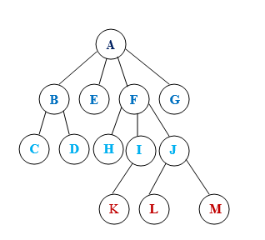
Tree Terminologies
Consider the following tree.

Slide 4
Tree Terminologies
Root: a node with out a parent. A
Internal node: a node with at least one child. A, B, F, I, J
External (leaf) node: a node without a child. C, D, E, H, K, L, M, G
Ancestors of a node: parent, grandparent, grand-grandparent, etc of a node.
Ancestors of K A, F, I
Descendants of a node: children, grandchildren, grand-grandchildren etc of a node. Descendants of F H, I, J, K, L, M
Depth of a node: number of ancestors or length of the path from the root to the node. Depth of H 2
Height of a tree: depth of the deepest node. 3

Slide 5
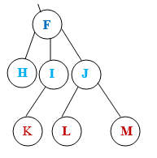

Tree Terminologies
Subtree: a tree consisting of a node and its descendants.
Binary tree: a tree in which each node has at most two children called left child and right child.

Slide 6



Tree Terminologies
Full binary tree: a binary tree where each node has either 0 or 2 children.
Balanced binary tree: a binary tree where each node except the leaf nodes has left and right children and all the leaves are at the same level.
Complete binary tree: a binary tree in which the length from the root to any leaf node is either h or h-1 where h is the height of the tree. The deepest level should also be filled from left to right.

Slide 7
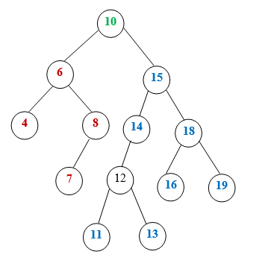
Tree Terminologies
Binary search tree (ordered binary tree): a binary tree that may be empty, but if it is not empty it satisfies the following.
Every node has a key and no two elements have the same key.
The keys in the right subtree are larger than the keys in the root.
The keys in the left subtree are smaller than the keys in the root.
The left and the right subtrees are also binary search trees.

Slide 8
Data Structure of a Binary Tree
struct DataModel
{
Declaration of data fields
DataModel * Left, *Right;
};
DataModel *RootDataModelPtr = NULL;

Slide 9
Operations on Binary Search Tree
Consider the following definition of binary search tree.
struct Node
{
Declaration of data fields
Node * Left, *Right;
};
Node *RootDataModelPtr = NULL;

Slide 10
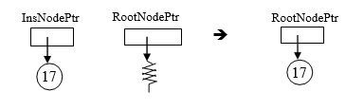
Insertion
When a node is inserted the definition of binary search tree should be preserved.
Suppose there is a binary search tree whose root node is pointed by RootNodePtr and we want to insert a node (that stores 17) pointed by InsNodePtr.
Case 1: There is no data in the tree (i.e. RootNodePtr is NULL)
The node pointed by InsNodePtr should be made the root node.

Slide 11
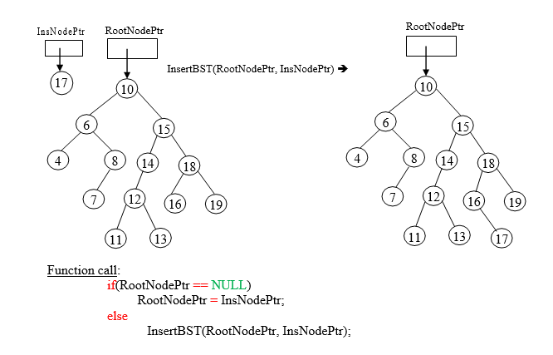
Insertion
Case 2: There is data
Search the appropriate position.
Insert the node in that position.

Slide 12
Implementation:
void InsertBST(Node *RNP, Node *INP)
{
//RNP=RootNodePtr and INP=InsNodePtr
int Inserted = 0;
while(Inserted == 0) {
if(RNP->Num > INP->Num) {
if(RNP->Left == NULL) {
RNP->Left = INP;
Inserted = 1;
} else
RNP = RNP->Left;
}
else {
if(RNP->Right == NULL) {
RNP->Left = INP;
Inserted = 1;
} else
RNP = RNP->Right;
}
}
}

Slide 13
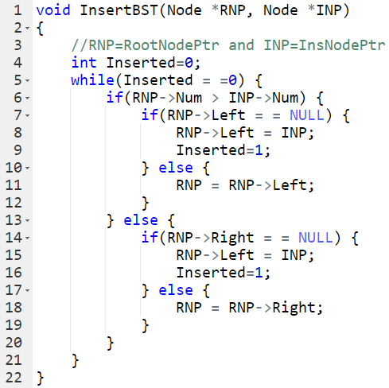
Implementation:

Slide 14
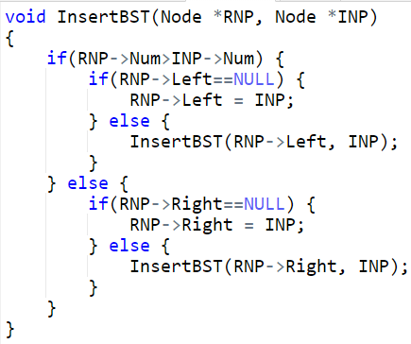
Implementation:
A recursive version of the function:

Slide 15
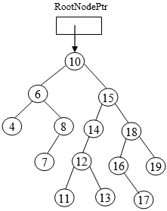
Traversing
Binary search tree can be traversed in three ways.
Pre order traversal- traversing binary tree in the order of parent, left and right.
Inorder traversal - traversing binary tree in the order of left, parent and right.
Postorder traversal - traversing binary tree in the order of left, right and parent.
Example:
Preorder traversal - 10, 6, 4, 8, 7, 15, 14, 12, 11, 13, 18, 16, 17, 19
Inorder traversal - 4, 6, 7, 8, 10, 11, 12, 13, 14, 15, 16, 17, 18, 19
==> Used to display nodes in ascending order.
Postorder traversal- 4, 7, 8, 6, 11, 13, 12, 14, 17, 16, 19, 18, 15, 10

Slide 16
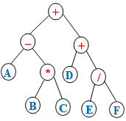
Application of binary tree traversal
Store values on leaf nodes and operators on internal nodes.
Preorder traversal - used to generate mathematical expression in prefix notation.
Inorder traversal -used to generate mathematical expression in infix notation.
Postorder traversal - used to generate mathematical expression in postfix notation.
Example:
Preorder traversal - + – A * B C + D / E F Prefix notation
Inorder traversal - A – B * C + D + E / F Infix notation
Postorder traversal - A B C * – D E F / + + Postfix notation
Function calls: Preorder(RootNodePtr); Inorder(RootNodePtr); Postorder(RootNodePtr);

Slide 17
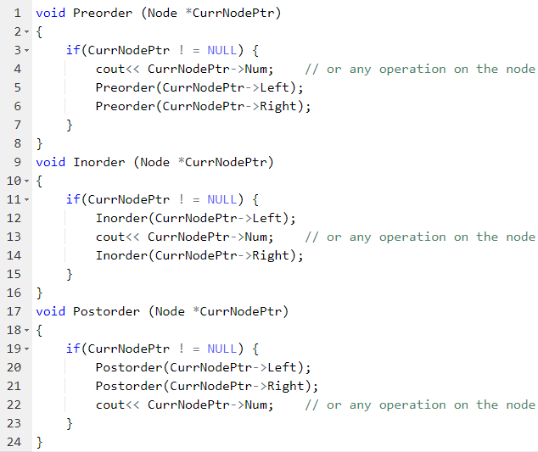
Implementation:

Slide 18
Implementation
Function calls:
Preorder(RootNodePtr);
Inorder(RootNodePtr);
Postorder(RootNodePtr);
void Preorder (Node *CurrNodePtr)
{
if(CurrNodePtr ! = NULL) {
cout<< CurrNodePtr->Num; // or any operation on the node
Preorder(CurrNodePtr->Left);
Preorder(CurrNodePtr->Right);
}
}

Slide 19
Implementation
void Inorder (Node *CurrNodePtr)
{
if(CurrNodePtr ! = NULL) {
Inorder(CurrNodePtr->Left);
cout<< CurrNodePtr->Num; // or any operation on the node
Inorder(CurrNodePtr->Right);
}
void Postorder (Node *CurrNodePtr)
{
if(CurrNodePtr ! = NULL) {
Postorder(CurrNodePtr->Left);
Postorder(CurrNodePtr->Right);
cout<< CurrNodePtr->Num; // or any operation on the node
}
}

Slide 20
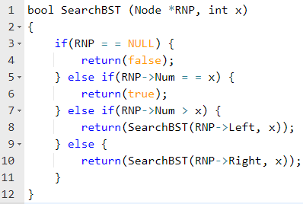
Searching
To search a node (whose Num value is Number) in a binary search tree (whose root node is pointed by RootNodePtr), one of the three traversal methods can be used.
Function call:
ElementExists = SearchBST (RootNodePtr, Number);
// ElementExists is a Boolean variable defined as: bool ElementExists = false;
Implementation

Slide 21
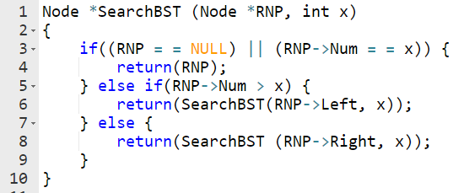
Searching
When we search an element in a binary search tree, sometimes it may be necessary for the SearchBST function to return a pointer that points to the node containing the element searched.
Accordingly, the function has to be modified as follows.
Function call:
SearchedNodePtr = SearchBST (RootNodePtr, Number);
// SearchedNodePtr is a pointer variable defined as:
Node *SearchedNodePtr=NULL;
Implementation:

Slide 22
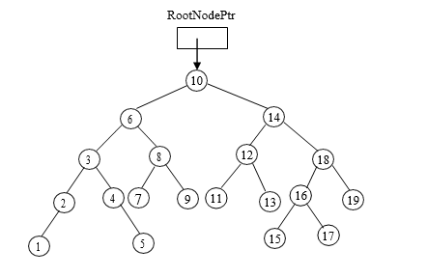
Deletion
To delete a node (whose Num value is N) from binary search tree (whose root node is pointed by RootNodePtr), four cases should be considered.
When a node is deleted the definition of binary search tree should be preserved.
Consider the following binary search tree.

Slide 23
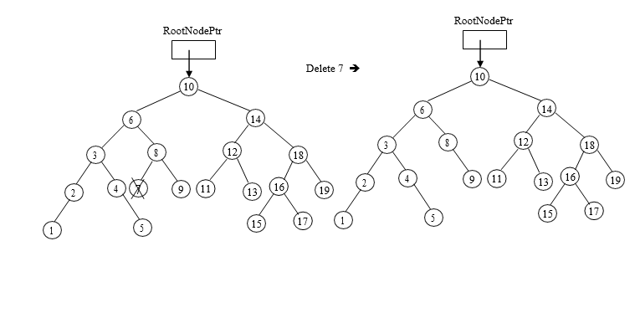
Deletion
Case 1: Deleting a leaf node (a node having no child), e.g. 7

Slide 24
Deletion
Case 2: Deleting a node having only one child, e.g. 2
Approach 1: Deletion by merging – one of the following is done
If the deleted node is the left child of its parent and the deleted node has only the left child, the left child of the deleted node is made the left child of the parent of the deleted node.
If the deleted node is the left child of its parent and the deleted node has only the right child, the right child of the deleted node is made the left child of the parent of the deleted node.
If the deleted node is the right child of its parent and the node to be deleted has only the left child, the left child of the deleted node is made the right child of the parent of the deleted node.

Slide 25
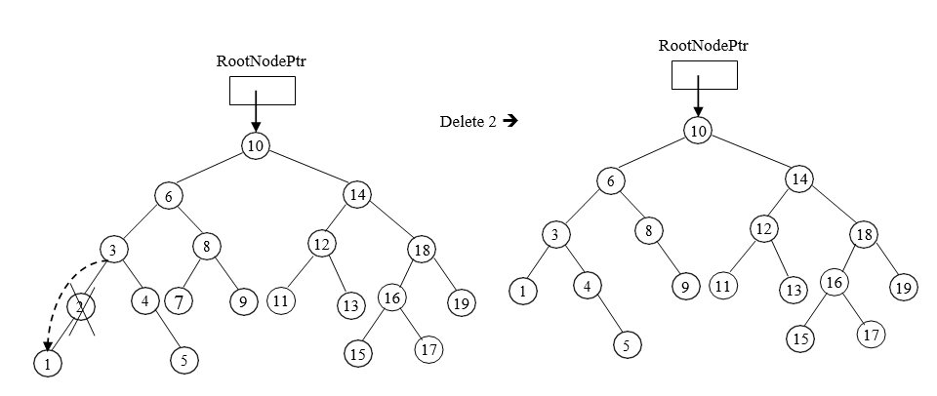
Deletion
If the deleted node is the right child of its parent and the deleted node has only the right child, the right child of the deleted node is made the right child of the parent of the deleted node.

Slide 26
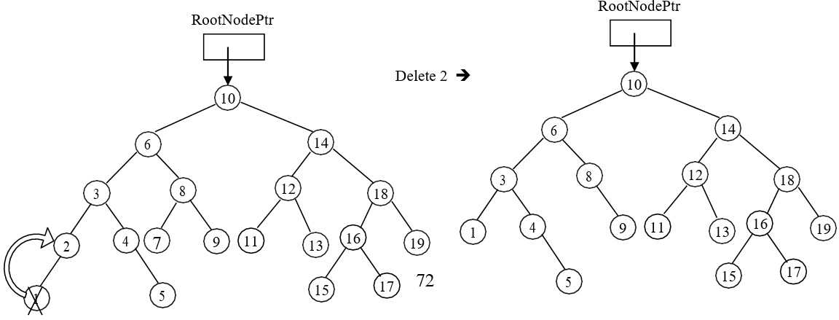
Deletion
Approach 2: Deletion by copying- the following is done
Copy the node containing the largest element in the left (or the smallest element in the right) to the node containing the element to be deleted.
Delete the copied node.

Slide 27
Deletion
Case 3: Deleting a node having two children, e.g. 6
Approach 1: Deletion by merging – one of the following is done
If the deleted node is the left child of its parent, one of the following is done
The left child of the deleted node is made the left child of the parent of the deleted node, and
The right child of the deleted node is made the right child of the node containing largest element in the left of the deleted node OR
The right child of the deleted node is made the left child of the parent of the deleted node, and
The left child of the deleted node is made the left child of the node containing smallest element in the right of the deleted node.

Slide 28
Deletion
Case 3: Deleting a node having two children, e.g. 6
Approach 1: Deletion by merging – one of the following is done
If the deleted node is the right child of its parent, one of the following is done
The left child of the deleted node is made the right child of the parent of the deleted node, and
The right child of the deleted node is made the right child of the node containing largest element in the left of the deleted node OR
The right child of the deleted node is made the right child of the parent of the deleted node, and
The left child of the deleted node is made the left child of the node containing smallest element in the right of the deleted node

Slide 29
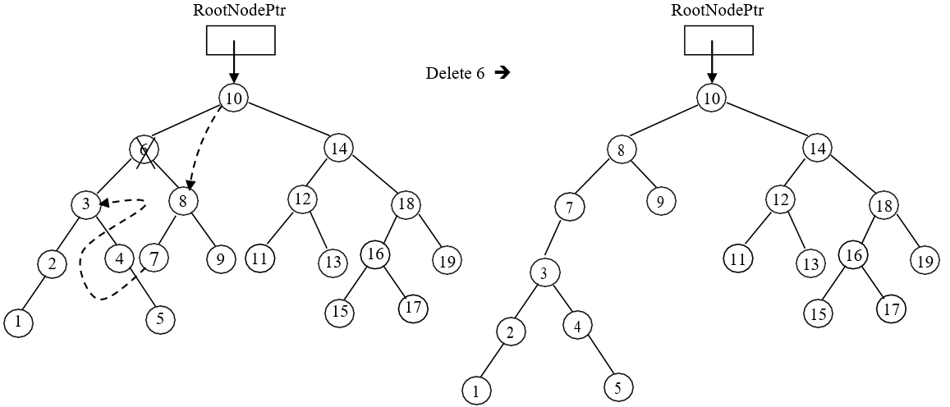
Deletion
Case 3: Deleting a node having two children, e.g. 6
Approach 1: Deletion by merging – one of the following is done

Slide 30
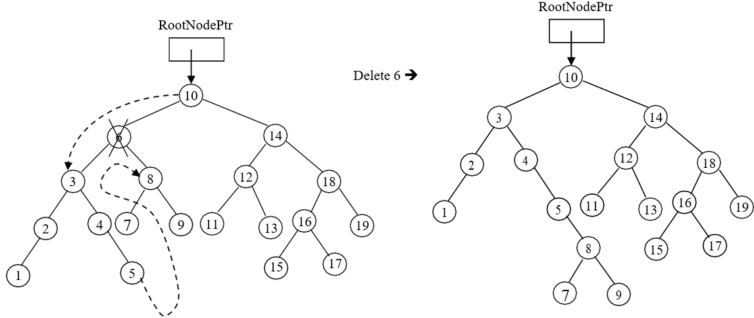
Deletion
Case 3: Deleting a node having two children, e.g. 6
Approach 1: Deletion by merging – one of the following is done.

Slide 31
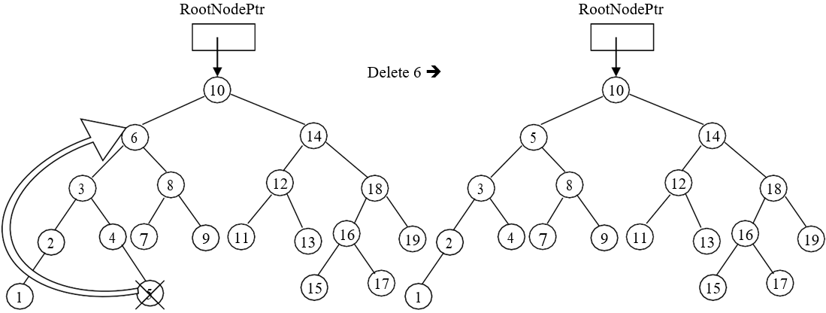
Deletion
Approach 2: Deletion by copying- the following is done
Copy the node containing the largest element in the left (or the smallest element in the right) to the node containing the element to be deleted
Delete the copied node.

Slide 32
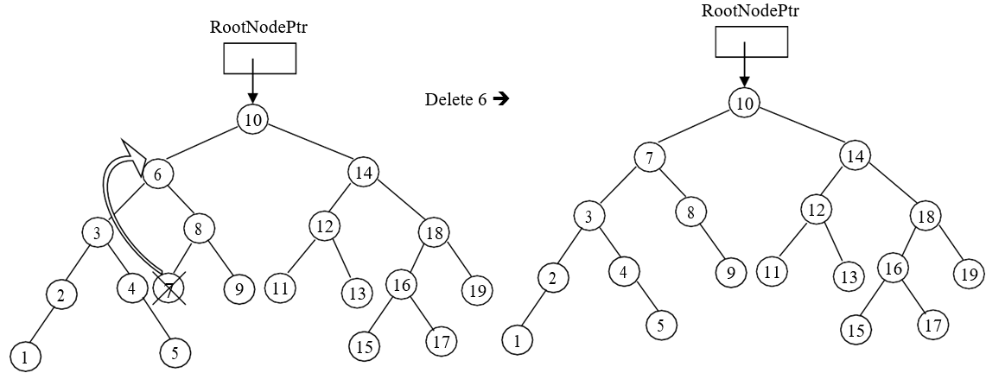
Deletion
Approach 2: Deletion by copying- the following is done
Copy the node containing the largest element in the left (or the smallest element in the right) to the node containing the element to be deleted
Delete the copied node.

Slide 33
Deletion
Case 4: Deleting the root node, 10
Approach 1: Deletion by merging- one of the following is done
If the tree has only one node the root node pointer is made to point to nothing (NULL)
If the root node has left child
the root node pointer is made to point to the left child
the right child of the root node is made the right child of the node containing the largest element in the left of the root node
If root node has right child
the root node pointer is made to point to the right child
the left child of the root node is made the left child of the node containing the smallest element in the right of the root node

Slide 34
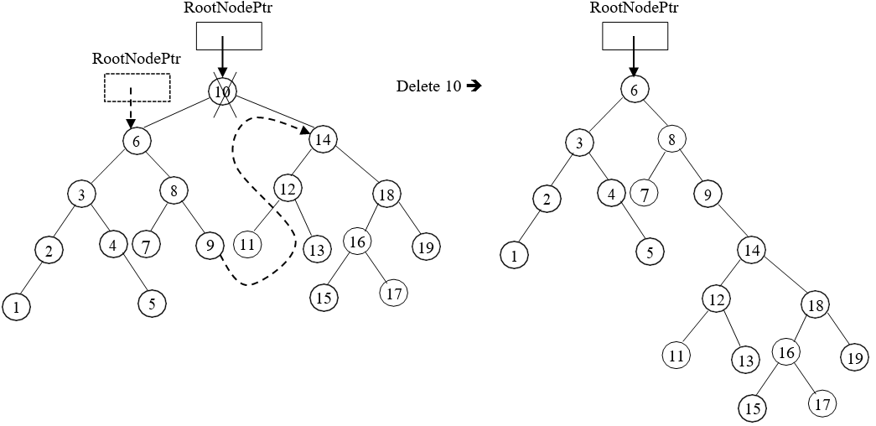
Deletion
Case 4: Deleting the root node, 10
Approach 1: Deletion by merging- one of the following is done.

Slide 35
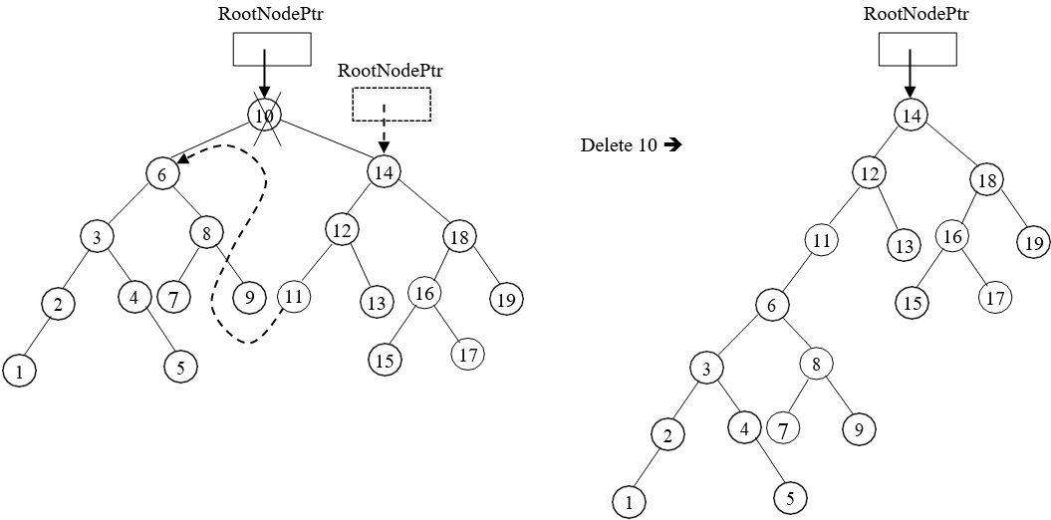
Deletion
Case 4: Deleting the root node, 10
Approach 1: Deletion by merging- one of the following is done.

Slide 36
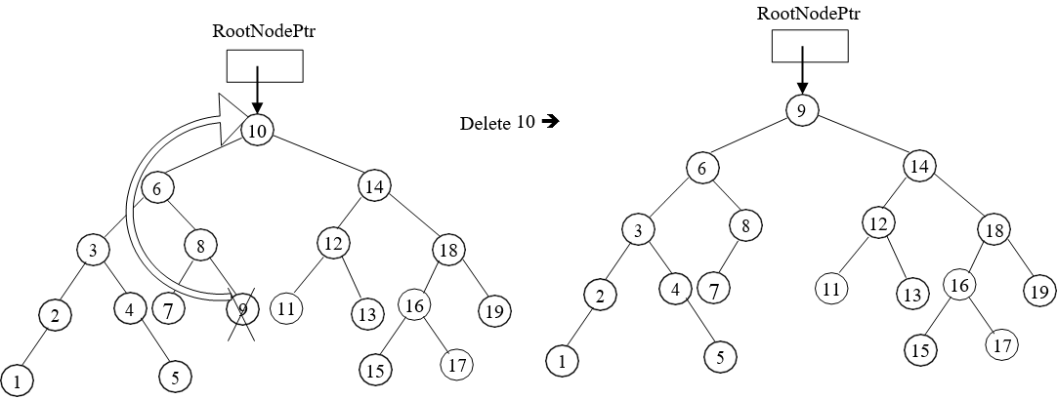
Deletion
Approach 2: Deletion by copying- the following is done
Copy the node containing the largest element in the left (or the smallest element in the right) to the node containing the element to be deleted
Delete the copied node.

Slide 37
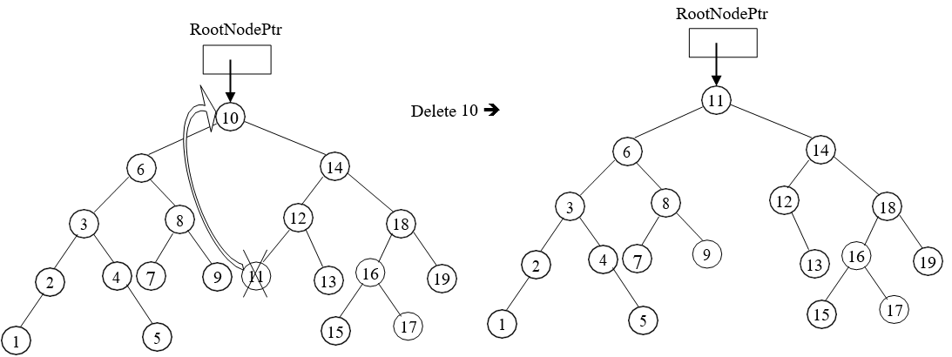
Deletion
Approach 2: Deletion by copying- the following is done
Copy the node containing the largest element in the left (or the smallest element in the right) to the node containing the element to be deleted
Delete the copied node.

Slide 38
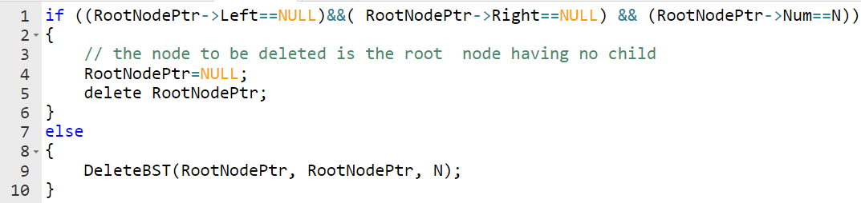
Deletion
Function call:

Slide 39
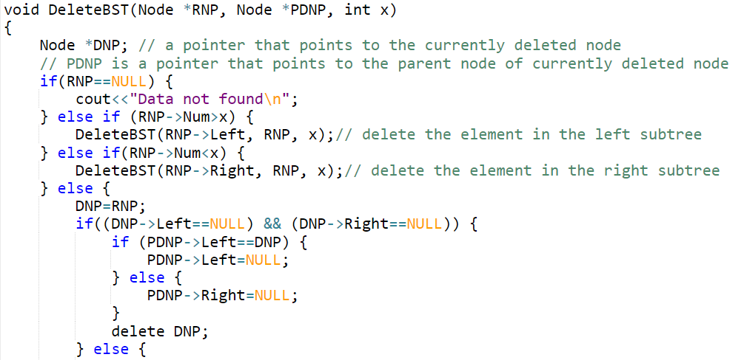
Deletion
Implementation:

Slide 40
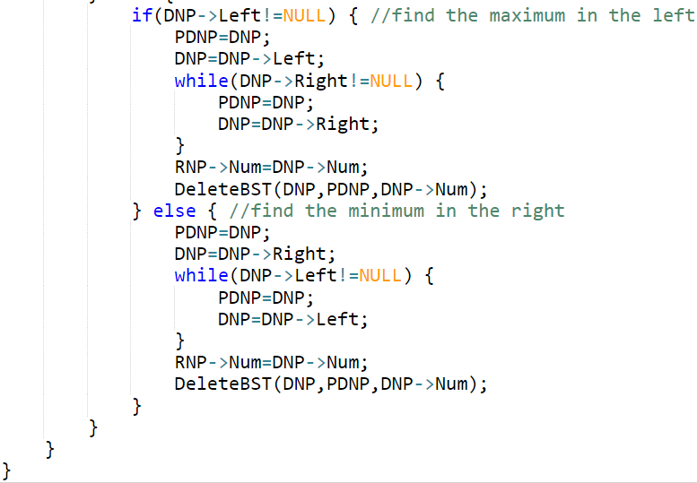
Deletion
Implementation:

